Slide 1
Smart station
Smart workstations for collaborative and coworking spaces
CSCI E-78 Wearable Technologies & IoT
Project 2
Brett Bloethner
Notes:
CSCI E-78 Wearable Technologies and IoT
Project 2
Brett Bloethner

Slide 2
The Problem and Opportunity
Traditional workspaces and offices make it difficult to foster a collaborative culture
Ineffective use of space
Cubicles and private offices take up much more space than open office floorplans
Formal meeting rooms take up space and don’t promote impromptu and constant collaboration
Lack of collaborative culture
Assigned desks make it difficult to work across business units and specialties
Employees who are able to move to different areas at work are 1.3x more likely to be engaged in their work (Gallup)
Traditional workspaces promote unhealthy lifestyles
Cubicles and sitting desks encourage sitting and poor posture
Employees should be sitting for only 2 hours per 8 hour workday
Companies are adopting standing desks and open workspaces because
Open workspaces have the ability to more efficiently use office space while also promoting collaboration (Gallup)
Standing desks have to ability to improve health and productivity (Washington Post)
Notes:
Traditional office spaces have a problem. People simply don’t work together when they’re not put together. Companies are wasting space and time by doing business in non-collaborative environments and they know it. To fix this, many companies are turning to open office layouts. This is a step in the right direction, but even with open office layouts, employees are still encouraged to do things the old way, sitting 8 hours a day and working very very independently. Open offices aren’t enough, they still can be non-collaborative and typically not ergonomic.

Slide 3
Smart station’s Purpose
Increase collaboration in the office
Smart Station workstations promote open work environments that will increase collaboration
Increase collaboration between business units
Desk Manager web app allows employees to easily reserve Smart Stations across the office or across the world
Increase employee/customer satisfaction
Smart Stations’ ergonomics capabilities and AI recommendation engine offers employees the opportunity to optimize their ergonomics for a more healthy lifestyle
Smart Stations’ ability to load your configurations instantly enable co-working spaces to personalize the experience they provide customers/members
Notes:
The Smart Station takes the open office concept a step further, increasing collaboration in the office and even between completely separate business units. It also helps fight poor ergonomics in the workplace, leading to a healthier more collaborative and more productive work force.

Slide 4
Benefits and advantages
The Smart Station is a standing desk that can automatically adjust itself to preconfigured positions
It dynamically adjusts 4 core desk ergonomics data points
Desk height
Monitor height
Monitor pan
Monitor tilt
It enables users to have the same desk ergonomics configuration at any Smart Station connected standing desk
It enables companies to create a collaborative atmosphere by
Allowing efficient and dynamic administration of desk space, letting employees work around who they need to when they need to
It enables co-working spaces to provide a personalized experience to customers who choose to use community desks
As a result, the Smart Station system will…
Save time by eliminating the need for employees to schedule time to work collaboratively
Increase Employee Health by promoting healthy ergonomics while at the desk
Increase Employee Gratitude by promoting a social and collaborative atmosphere where employees are encourage to work together, building relationships
Notes:
The Smart Station is a truly intelligent and connected standing workstation. With automated adjustments for height, monitor height, pan, and tilt, the Smart Station can accommodate any employees preferred ergonomics. Users’ settings are also saved on the cloud that way a user can experience their same ergonomics configurations at any Smart Station in the office or in the world. This is especially valuable for co-working spaces that often see members using a different workspace each day.

Slide 5
Scenario one
Employee uses the biometric login feature to auto adjust a Smart Station
Scenario one uses the Smart Station biometric reader as well as Desk Manager
Smart Station features a biometric fingerprint scanner for user authentication
Unique biometric identifier is linked to a Desk Manager user account
Smart Station uses the Desk Manager API and a custom Android tablet built into the desk
After successful authentication…
User’s last used configuration is put into position
User’s automatically scheduled configuration changes will execute on time
Unoccupied Smart Stations return to a low-height idle position so users can easily spot available stations
Notes:
Logging into a Smart Station is simple. Just swipe your finger on the biometric fingerprint scanner and your Smart Station will adjust to the height you’ve programmed in previously. This is all powered by the Desk Manager web app and API, a powerful management tool for organizing Smart Stations at scale.

Slide 6
Scenario one Interaction Flow EMPLOYEE USES THE BIOMETRIC LOGIN FEATURE TO AUTO ADJUST THE SMART STATION
Employee (user) arrives at the office campus. They work part of the day in their usual area in Building 1.
They prepare their belongings and press “leave workstation” on the Smart Stations built in touch screen.
They arrive in the BUs work area and search for an open Smart Station. They find an available Smart Station quickly since the low height idle state configuration is an unusual configuration for others to use.
User receives a call to help another BU with a topic they specialize in.
They scan their finger to login to the Smart Station. The workstation then reconfigures itself to match the users last desk configuration used in Building 1.
User finishes the day working right with the BU he’s assisting with, enabling him to have impromptu and casual collaboration throughout the day since he’s working in their same physical area.
The workstation returns to its lowered idle configuration to show the user he has successfully logged out. User heads to Building 2.
Notes:
Ad libbing off of slide.

Slide 7
Scenario two
Administrator uses Desk Manager to place temp consultant with relevant team
Scenario one uses the Desk Manager web app feature
Desk Manager is used to manage Smart Stations and store user configurations/profiles
With Desk Manager, administrators can…
Assign Smart Stations to individuals or guests temporarily or permanently
Issue temporary access code so guests don’t have to create accounts
Provision and deprovision user access
Configure Desk Manager and Smart Stations settings
Notes:
Guests can use Smart Stations too. With Desk Manager, any administrator can grant a guest a Smart Station account authenticated either by fingerprint or temporary access code. With this feature, management can be sure that temp workers, guests, contractors, and consultants are always stationed in the best possible spot for optimum productivity, collaboration, and efficiency with the daily work force.

Slide 8
Scenario two interaction flow Administrator uses Desk Manager to place temp consultant with relevant team
Team lead/Desk Manager admin wants a temporary consultant to sit with this team and help them for a few weeks.
They run a search for 5 (his team size + 1) nearby desks open near each other during the time frame the consultant is helping them.
He finds available desks and reserves them for his team.
Each desks adjusts to the correct ergonomics configuration and continues to behave as each user account/schedule dictates.
The team lead uses the Desk Manager web app SAML authentication feature to log in with his corporate username and password.
Each team member and the consultant receive an email from the Desk Manager system with their desk location for that time frame.
The next day team members and the consultant arrive at their reserved desks and swipe their fingers to log in. (consultant uses a temporary access code)
Notes:
Ad libbing off of slide.

Slide 9
Scenario three
Co-working space issues Smart Station accounts for customers
Scenario three also uses the Desk Manager web app feature
Co-working spaces allow members to come in and use any available desk
Smart Stations allow members to use their ergonomics preferences any desk
After signup, members are issued a setup access code
Members then type the code into any Smart Station and complete the desk setup wizard
Notes:
Smart Stations have an extremely valuable proposition for co-working spaces. Many co-working space members simply drop in a choose an open desk, this means they may or may not get a desk they find comfortable and ergonomic. With a system of Smart Stations, co-working spaces can be sure that their members are comfortable and productive since every Smart Station can adjust itself to any users preferences in a matter of seconds.

Slide 10
Scenario three interaction flow Co-working space issues Smart Station accounts for customers
A new member to a co-working space completes the onboarding process which includes creating a Smart Station account on a Desk Management instance (private or public)
On the members first day they approach any Smart Station and scan their thumb.
The Smart Station won’t recognize the user and will instead ask for a one time access code or a new user code.
The user types in the one time setup code and authenticates with the Smart Station.
Member receives an email with one time setup code.
Now the user can successfully biometrically log into any Smart Station connected to that same Desk Management system (such as other co-working space locations).
The Smart Station then has the user complete a setup wizard where the user will configure their default desk and monitor ergonomics configuration.
Notes:
Ad libbing off of slide.

Slide 11
Scenario four
Employee finds a desk upon entering work in a hyper open workspace
Scenario four uses the Find a Desk in the Desk Manager web app
Find a Desk allows users to look for and reserve available desks in real time
Users could also opt into getting desks auto assigned/reserved
They receive an email each morning with that days desk assignment
Notes:
Smart Stations also encourage hyper open office layouts and can allow an office to work effective and efficiently with no assigned desks at all. The Desk Manager ‘Find a Desk’ feature enables employees to locate an empty desk in real time, making sure not a single second is lost in the search for an open desk. With dynamic desk assignments, employees are encourage to acquaint themselves with one another rather than only the workers in their neighboring cubicles.

Slide 12
Scenario three interaction flow Employee finds a desk upon entering work in a hyper open workspace
Employee (user) enters the office for the day and their mobile device connects to the LAN, where the on premises Desk Manager web app is accessible
A pre-programmed layout of the office comes up, showing the user where available Smart Stations are at that very second.
The user selects a Smart Stations and approves the on screen prompt asking if they would like to reserve the Smart Station
The user walks to the Smart Station they reserved and swipes their finger to login.
User opens the Desk Manager web app via a web browser on their smart phone and taps "Find an Open Station"
The user continues to work throughout the day using the functionality of the Smart Station until they swipe their finger again to logout and leave the office.
The Smart Station will adjust to the users default or time scheduled ergonomics position.
Notes:
Ad libbing off of slide.

Slide 13
Smart station system requirements
Each Smart Station requires…
An ethernet connection
Smart Stations pre-configured to use the Desk Manager public infrastructure
A monitor with VESA mount capabilities
A connection to the Desk Manager public web app or a privately hosted instance of Desk Manager
Use of the Desk Manager web app requires
Computer with internet access (required only for administration)
Or access to a Smart Station that’s connected to the web (required for typical use and user onboarding/setup)
Privately hosted instances of Desk Manager may be configured to require…
Corporate authentication credentials (SAML, LDAP, Oauth)
Customer Relationship Management (CRM) tools (for public applications where users are also customers such as co-working spaces)
ERP tools or communication tools such as Microsoft Exchange for managing and scheduling Smart Stations in corporate workspaces
Small Ecosystem
The entire Smart Station system includes only the Desk Manager web app and an unlimited number of Smart Stations (Android tablet is part of the Smart Station)
Notes:
Each Smart Station requires an ethernet connection and a connection to an instance of the Desk Manager web app as well as a monitor with VESA mount compatibilities. The Desk Manager app requires a computer to login and manage Smart Stations. An on premises version of Desk Manager is also available and requires a few more technical items. The ecosystem is extremely simple and incorporates only two things; an unlimited number of Smart Stations and a Desk Manager app.

Slide 14
PRIMARY UI Design GOALS
One button use after onboarding/setup
Users must be authenticated to load customer settings so one ‘button’ is unrealistic
Biometric fingerprint scanning authenticates the user in one painless interaction, loading ergonomics settings instantly
Scheduling allows users to automate ergonomics changes so the Smart Station requires little interaction
AI powered ergonomics recommendations can be executed automatically, further decreasing interaction
Extend functionality infinitely by allowing 3rd party integrations
Multi purpose Android tablet built into desk to extend capabilities for integrations and future features
Extensive API at the Android tablet allows for seamless integration into the desks sensors and actuators
Desk Manager API enables access to users ergonomics configs. as well as ergonomics schedules and time series data points
Interactions with the Android device must not be vital to the most elementary use of the Smart Station
Some users may only want to use minimum functionality since they may be employees who are forced to use Smart Station
Notes:
After the initial setup, using a Smart Station is extremely simple. Swipe your finger to login and the Smart Station adjusts to your default configuration or your configuration according to your preprogrammed ergonomics schedule. Continue through your workday and accept or reject ergonomics recommendations powered by your Smart Station’s camera and AI feature. Third party integrations are also available. In the future these could incorporate workplace apps like Slack right into the Smart Stations custom Android tablet which acts as the built in control center for everything Smart Station.

Slide 15
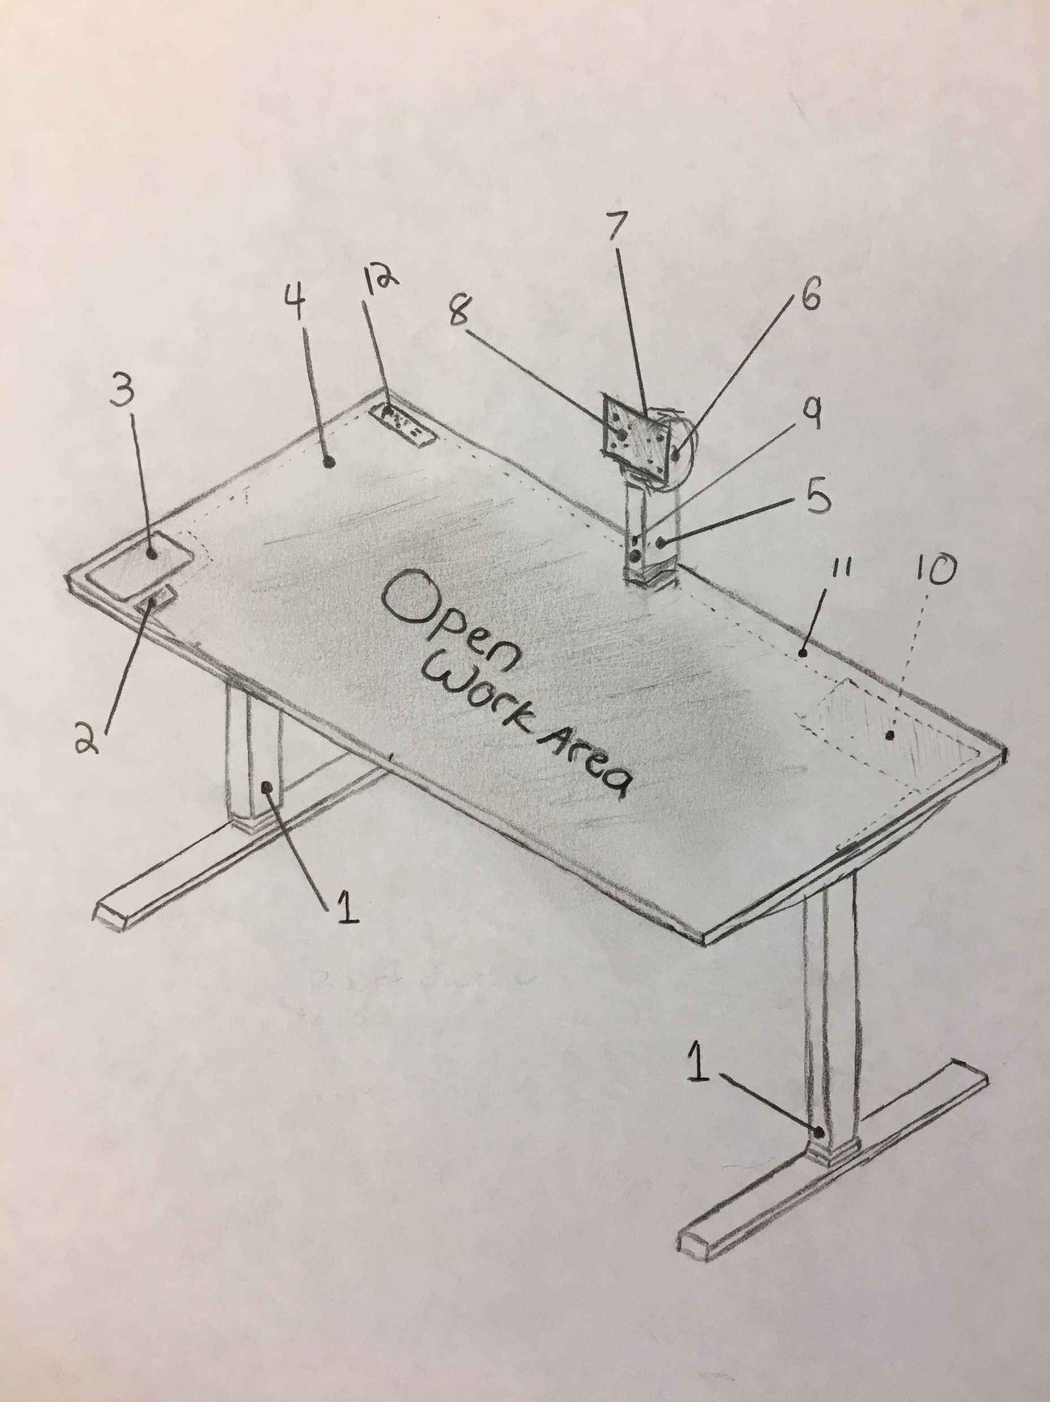
Industrial design
isometric sketch
Smart Station Desk Leg
Linak DB6 3 stage linear actuator
Generic Biometric Fingerprint Scanner
User authentication with the swipe of a finger
Custom Android Tablet
Built into the table (non removable)
Gorilla Glass for durability
Custom Android distribution
Tablet sends signals to the control unit (10)
Open API allows third party integrations with the Smart Station
Laminate Table Top for durability
Smart Station Monitor Arm
Linak LA22 in-line actuator
Designed for use where space is limited
Responsible for adjusting monitor height
Notes:
Ad libbing off of slide.

Slide 16
Industrial design
isometric sketch
Monitor tilt joint
Stepper motor or servo motor based rotary actuator
Responsible for adjusting monitor tilt
Monitor pan joint
Stepper motor based rotary actuator
Responsible for adjusting the monitor pan angle
VESA Mount Plate
Monitor mounted using a standard VESA mount compatible with almost all monitors
Mount plate assembly turns to adjust monitor roll (landscape to portrait) and is not automated
Camera
Interfaces with the Android tablet through the control unit
Assists AI technology to determine posture changes
Control Unit (underside of Smart Station)
Custom manufactured
Interface between the tablet, actuators, camera and fingerprint scanner
Contains electrical components necessary to engage high energy demanding actuators
Contains PSU and Ethernet interface for the Android device
Notes:
Ad libbing off of slide.

Slide 17
Industrial design
isometric sketch
Integrated Wiring (underside of Smart Station)
Wiring installed in channels underneath desk
Channels can also be used for standard keyboard, mouse, laptop, and monitor cabling
Power and USB outlets
Standard dumb power outlets
Standard dumb USB power outlets
Allows user to quickly and easily swap devices to a different Smart Station without reaching under the table for a power strip
Notes:
Ad libbing off of slide.

Slide 18
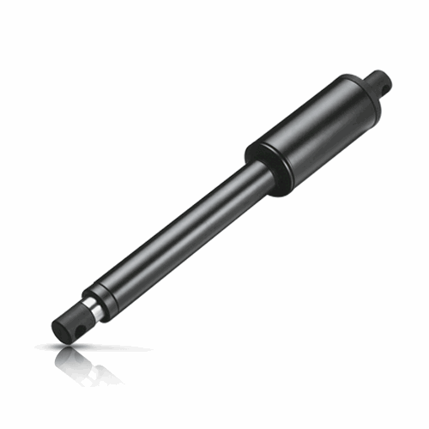
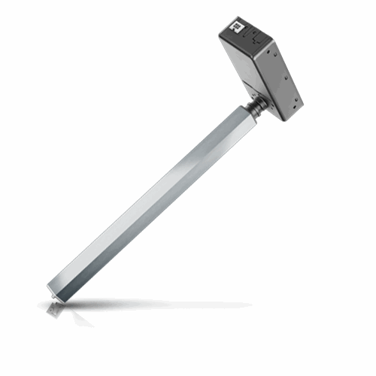
Industrial design
PARTS
LA22 in-line actuator
Built by Linak Technologies
Designed for applications where space is limited
Moves at speeds of 1.46 in/s
DB6 3 stage linear actuator
Built by Linak Technologies
Designed for height adjustable desk applications
Adjustable in height from 600mm to 1,200mm
Moves at a speeds of 1.5 in/s
Low noise level
Custom manufactured control unit
Uses the Linak DESKLINE interface standard
Includes USB interfaces for tablet, camera, and fingerprint scanner
Most other parts are not specialized and can be purchased and tested using generics suppliers
Notes:
The Smart Station is powered by a series of actuators from Linak, a leading manufacture of standing desk components. 3 Linak actuators are accompanied by two rotary actuators that control the monitors pan and tilt as well as a custom built control unit that acts as the interface between the actuators, sensors and ethernet and the Android tablet. Many of the non-Linak parts such as the tabletop, camera, and the fingerprint scanner, can be sourced from generic suppliers.

Slide 19
Desk manager application (administrators)
A few companies are already doing smart standing desks but don’t include an enterprise workspace organization tool!
Admins may use the Desk Manager web app to…
Reserve or assign desks for individual users
Assigned desks are then restricted to only that individual for that period of time
Configure desk availability strategies
First com first serve (reserve for the day)
Reservation only
Open use (for areas with many guests, allows manual desk controls without authentication)
Create zones of Smart Stations with their own unique configurations
Configure rules for specific departments or business units
Provision users and configure their access to certain desks, zones, and Smart Station features such as integrations
View metrics involving Smart Station usage
Notes:
Ad libbing off of slide.

Slide 20
Desk manager application (users)
Users may use the Desk Manager web portal to…
Manage personal ergonomics presets
Manage personal ergonomics preset scheduling
Adjust settings associated with their user account/profile
Reserve or request a desk somewhere
View available open desks in real time
Receive notifications (via email) from the Desk Manager web app about
Changes made by administrators
Desk reservation reminders and notifications
Most user interaction happens on the Android tablet which uses the more fully featured Desk Manager API
Notes:
Ad libbing off of slide.

Slide 21
Desk manager on the public cloud
Desk Manager on the public cloud is maintained by the Smart Station company and is accessible worldwide
By default, Smart Stations are configured to interface with the Desk Manager public cloud infrastructure
Single purchase customers/users will most likely use this variation of Desk Manager to log into their Smart Station
Authentication is provided using methods standard to public web apps, then the account is associated with the biometric fingerprint at time of first interaction with a Smart Station
Username & Password
Facebook login
Google login
Twitter login
With the public cloud variation, all configurations are property of the end user and only they can view, modify, or delete their account
End users on the public cloud version can log into any other Smart Station that’s also on the public cloud Desk Manager web app
Registration is online, the user receives a code they type into their Smart Station tablet before swiping their finger and completing the setup
Notes:
The standard Desk Manager web app lives on the public cloud and is maintained by the Smart Station company. Smart Stations are shipped to work with this version of Desk Manager by default but can be configured to work with on premises instances of Desk Manager instead. Smart Stations connected to the public cloud Desk Manager can load anyone's Smart Station settings from anywhere in the world, making this feature very attractive to public and co-working spaces. Authentication into the Desk Manager app can be done using standard username and password or via a social account such as facebook.

Slide 22
Desk manager on premises
Desk Manager on premises is provided free of charge but must be installed and maintained by the end user on their own infrastructure
Smart Stations must be configured after purchase to work with a privately hosted version of the Desk Manager web app
The server hosting Desk Manager must have a static IP address and support for HTTPS SSL/TLS encryption
Configuration is done from the Android tablet welcome screen where there will be an option and wizard to guide a technician through the configuration process
Corporate purchasers of Smart Stations will most likely prefer this variation since it offers things such corporate login and physical security
Additional authentication is provided using methods popular in large enterprise environments (SAML, LDAP, Google, Oauth)
With the privately hosted variation, all configurations are controlled by the Desk Manager administrator who can…
Add users and provide them with setup codes via automated email
Remove users
Add guest users via temporary user account or temporary access code
End user accounts on a privately hosted Desk Manager web app will only work on Smart Stations on that specific instance of Desk Manager
Notes:
The on premises version of Desk Manager is designed for enterprises and must be maintained by that enterprises IT support staff. The feature set is slightly different in that the on premises version allows login via username or password and corporate authentication methods such as SAML or LDAP, rather than social accounts. With the on premises instance, only administrators have the ability to add and remove user accounts and provision features like integrations for users.

Slide 23
Smart station desk Android OS
The Smart Station is controlled by an custom Android tablet built into the tabletop
Custom Android distribution that interfaces with the desk’s control unit
Locked from other standard Android functionality for
Security
Efficiency
Open to approved 3rd party integrations such as…
Workplace chat apps
Workplace scheduling apps
Food ordering apps
Ergonomics related apps
Healthy work lifestyle related apps
Notes:
Smart Stations are controlled via a custom built Android tablet that’s built into the Smart Desk tabletop. In an effort to keep the device safe and efficient, a custom Android distribution is used which locks the tablet into only being able to use features related to Smart Stations and Smart Station approved integrations.

Slide 24
AI and Integrations
AI, machine learning, and integrations are provided for the convenience of the end user.
The related features provide no benefit to administrators of Smart Station systems
Integrations API
Open API
Requires approval to distribute apps to Smart Station Android tablets
Provides desk location and user time series ergonomics data
AI and Machine Learning
Provides posture and ergonomics suggestions to user
Physiological data surveyed during setup
Posture changes detected by the camera watching for face position and distance from screen
Ergonomics recommendations made accordingly in real time
Notes:
AI and machine learning is used in conjunction with the Smart Station camera to determine and map the users ergonomics and posture habits and provide healthy ergonomics recommendations such as standing up straight or taking a short walk. An API is also provided which allows 3rd parties to access data points related to users ergonomics over time. Physiological data such as height, weight, face mapping, etc… is surveyed on first setup that way the camera can be properly calibrated to detect changes in posture.

Slide 25
Device TECHNICAL ARCHITECTURE Overview
Control Unit
Takes in standard power input and houses the device’s interfaces between the Android tablet and actuators, ethernet, fingerprint scanner, and camera.
DB 6 Actuator (x2)
LA 22 Actuator
Rotary Actuator
Rotary Actuator
Android Tablet
Camera
Fingerprint Scanner
Ethernet Adapter
Other
All non-actuator devices are connected to the control unit via a USB communication protocol and a proprietary API
Actuators
Actuators interface with the control unit using Linak’s specially designed DESKLINE communications standard
Notes:
Ad libbing off of slide.

Slide 26
CLOUD Service ARCHITECTURE
3rd Party Authentication Services
MongoDB Cluster
Application Infrastructure Cluster
HTTP REST API
3rd Party AI and Machine learning Services
www
Ethernet Wi-Fi
Desk Manager Web App Front-End in Browser
Smart Station Actuators
Smart Station Control Unit
On Premises
Wi-fi/ethernet connection would be replaced with a similar connection but to a local network. The API and Infrastructure would then live on a local server. 3rd party authentication service capabilities may then be provided by local or cloud enterprise solutions.
Smart Station Android tablet
Finger Print Scanner
Smart Station Camera
Notes:
Desk Manager includes a standard HTTP REST API interface that powers all of the communication between the Smart Station and Desk Manager infrastructure. The control unit then sends signals to the actuators and acts as the interface for the sensors (camera and fingerprint scanner). A standard MongoDB cluster is used for persistence and a few 3rd party APIs are used for things like Oauth, social auth, corporate auth, and AI and machine learning.

Slide 27
Going to market enterprise sales
Companies may purchase Smart Stations in bulk for an entire office
Enterprise sales must build relationships with companies interested in moving to an open office design
Provide professional services for the transition to an open office design with Smart Stations
Allow customers to contract out Smart Station office designers for the transition and addition of Smart Stations
Allow customer to contract out Smart Station technicians for the assembly and installation of Smart Stations on site
They may also choose to host a private instance of Desk Manager
Provide professionals services for enterprises wanting on premises solution
Marketing to enterprises will need to be done via trade shows, conferences, and trade magazines
Notes:
Enterprise sales will require that sales reps build relationships with potential customers. A few things we can offer early adopters are assistance in assembling and configuring Smart Stations on site as well as assistance in office redesigns to accommodate a series of Smart Stations. We could also provide professional services in the realm of setting up and maintaining on premises Desk Manager instances on private cloud services like AWS. Either way, we will still have to market via trade shows, conferences and business magazines.

Slide 28
Going to market developer advocacy and partnerships
Integrations add value to the Smart Station system
Provide support for companies interested in building integrations for Smart Stations
Provide marketing through partnerships with companies who have integrations with Smart Stations
Slack
HipChat
Microsoft Exchange
Partner with office design firms to promote the incorporation of Smart Stations in office renovations
Notes:
Integrations add value to the Smart Station platform free of any costs to us. So we can and should promote developers creating integrations for Smart Stations. One way we can do this is by highlighting popular integrations in our marketing materials, helping those tools in marketing just like they help to make our IoT device more valuable. Partnerships with design firms could also help us get our name out there as a potential option for companies looking to redesign their office with an open office strategy.

Slide 29
Going to market Consumer sales
Typical targeted marketing channels
Instagram
Facebook
Twitter
Target individuals interested in ergonomics and modern office spaces
Influencer marketing
Hire influencers to promote Smart Stations on social media
Notes:
Consumer sales would see the typical tech startup marking strategies such as targeted advertising on social media as well as influencer marketing. Specifically we would be targeting people interested in healthy living, ergonomics, co-working, or modern offices.

Slide 30
References and Image Sources
https://mobilitymgmt.com/articles/2015/02/03/study-sit-to-stand-ratio.aspx?admgarea=research
https://www.linak-us.com/products/linear-actuators/db6/#/productdescription
https://www.linak-us.com/products/linear-actuators/la22/#/productdescription
https://en.wikipedia.org/wiki/Rotary_actuator
https://news.gallup.com/opinion/gallup/212741/open-office-floor-plan-work.aspx
https://www.washingtonpost.com/lifestyle/wellness/standing-desks-boost-productivity-not-just-health-study-finds/2016/05/31/b7948390-2358-11e6-8690-f14ca9de2972_story.html?utm_term=.bc07c3b05917
Notes:
Done.

